Slide 1
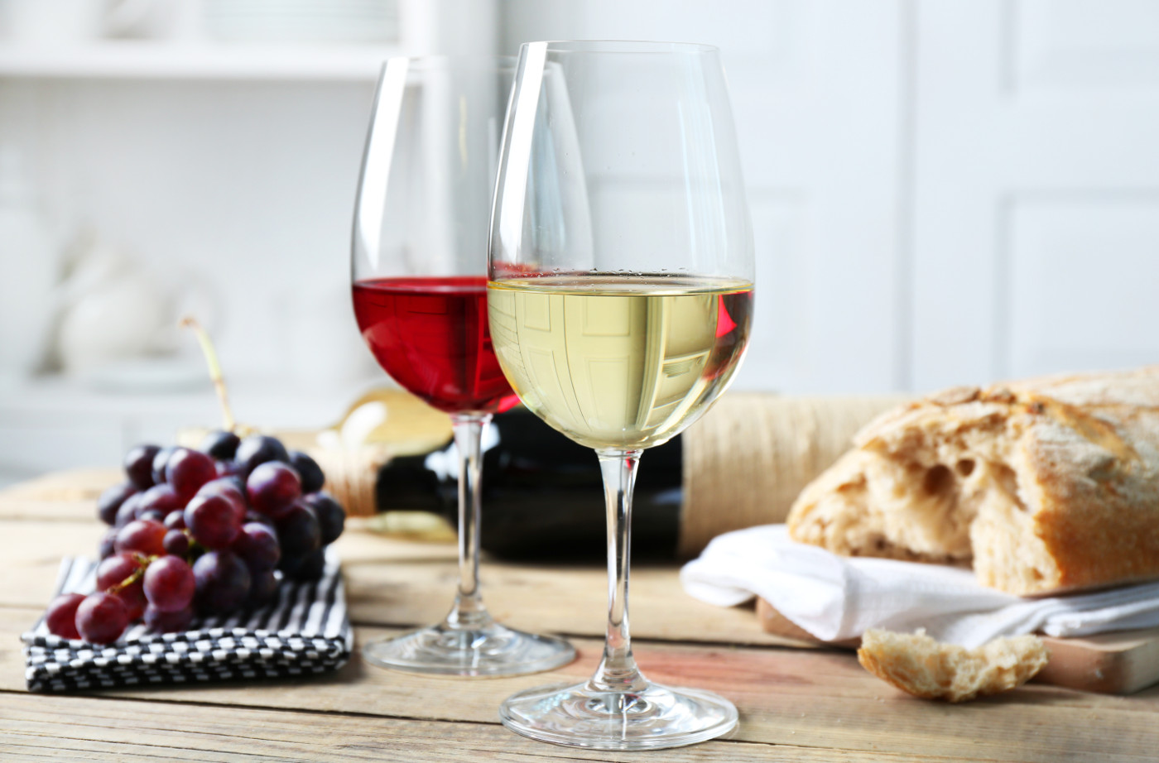
Predicting Wine Quality
Using Seaborn, MAT plotlib and Machine learning
Ahmad Aldarwish

Slide 2
Objective
The Datasets contain information about red and white wine
The dataset has 1000 data points of each wine with 13 characteristics (attributes)
Wine quality is measured on 0(low)-10(high)
Goal is to understand the characteristics of these wines and how different ingredients affect the quality (target)

Slide 3
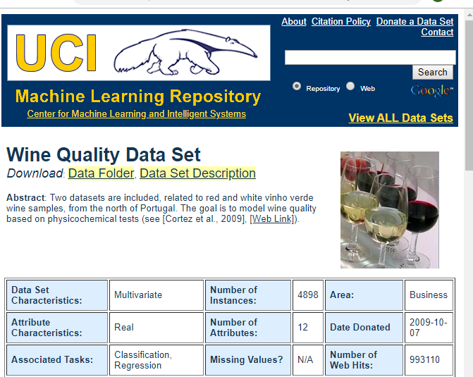
Data
UC Irvine’s Machine Learning Repository
Red Wine and White Wine

Slide 4
Features
1 - fixed acidity: most acids involved with wine or fixed or nonvolatile (do not evaporate readily)
2 - volatile acidity: the amount of acetic acid in wine, which at too high of levels can lead to an unpleasant, vinegar taste
3 - citric acid: found in small quantities, citric acid can add ‘freshness’ and flavor to wines
4 - residual sugar: the amount of sugar remaining after fermentation stops, it’s rare to find wines with less than 1 gram/liter and wines with greater than 45 grams/liter are considered sweet
5 - chlorides: the amount of salt in the wine
6 - free sulfur dioxide: the free form of SO2SO2 exists in equilibrium between molecular SO2SO2 (as a dissolved gas) and bisulfite ion; it prevents microbial growth and the oxidation of wine
7 - total sulfur dioxide: amount of free and bound forms of S02S02; in low concentrations, SO2SO2 is mostly undetectable in wine,
but at free SO2SO2concentrations over 50 ppm, SO2SO2 becomes evident in the nose and taste of wine
8 - density: the density of water is close to that of water depending on the percent alcohol and sugar content
9 - pH: describes how acidic or basic a wine is on a scale from 0 (very acidic) to 14 (very basic); most wines are between 3-4 on the pH scale
10 - sulphates: a wine additive which can contribute to sulfur dioxide gas (S02S02) levels, wich acts as an antimicrobial and antioxidant
11 - alcohol: the percent alcohol content of the wine

Slide 5
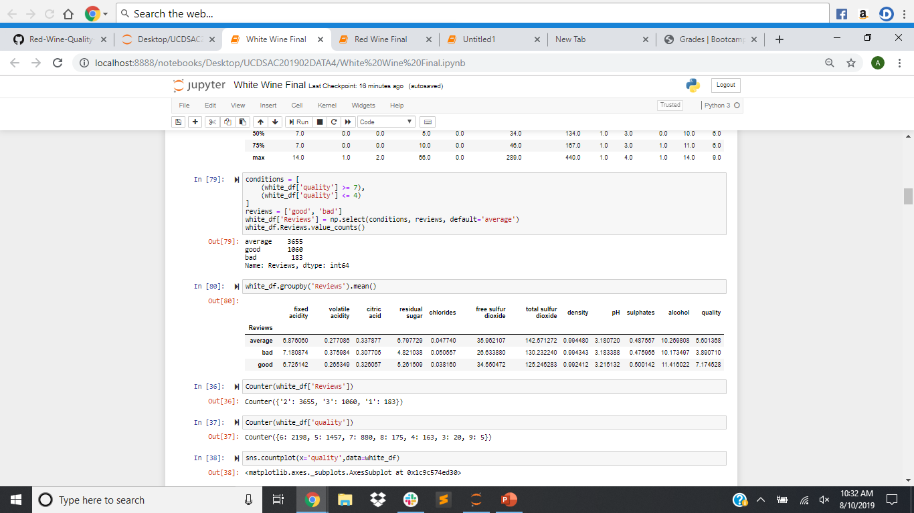
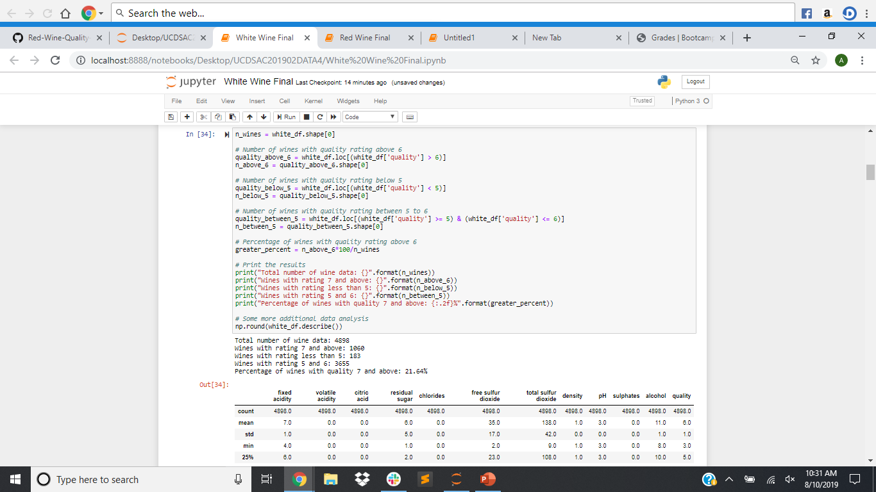
Cleaning

Slide 6
Plots
Refer to Juniper Notebook

Slide 7
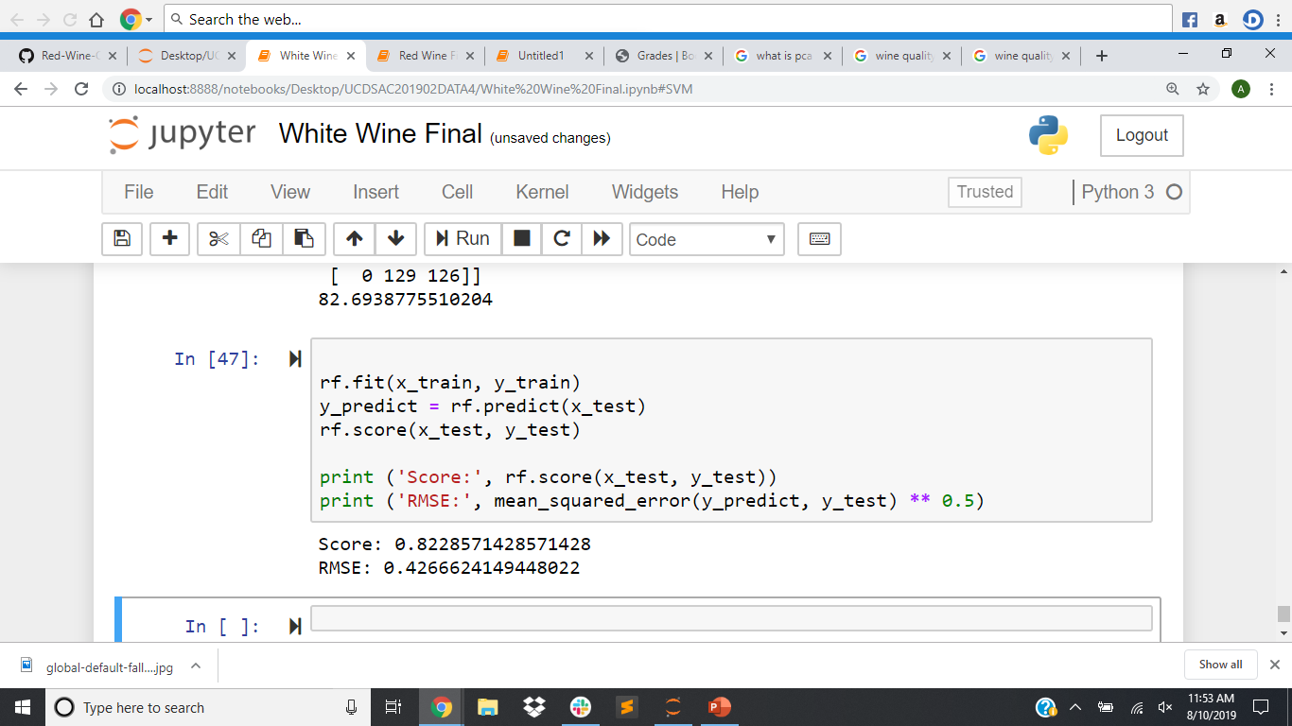
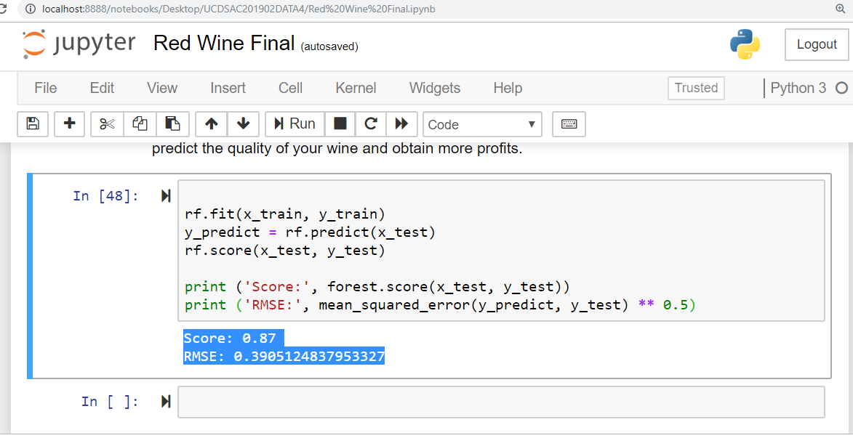

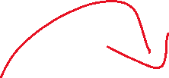
Modeling
Proceed with Modelling. I will use the following algorithms
Logistic Regression
Decision Trees
Naive Bayes
Random Forests
SVM

Slide 8
Conclusion
I observed the key factors that determine and affects the quality of the red wine. Wine quality is ultimately a subjective measure. The ordered factor 'quality' was not very helpful and to overcome this, so I created another variable called 'Reviews'.
To make predictions of wine quality and any other if required, I trained three models. As seen, the GaussianNB and Logistic Regression model along with Random Forest Classifier. The Random Forest Classifier performed marginally better and I decided to stick with it if we had to make any more predictions.
The usage of this analysis will help to understand whether by modifying the variables, it is possible to increase the quality of the wine on the market. If you can control your variables, then you can predict the quality of your wine and obtain more profits.

